Slide 1
Power BI Advanced Data Visualization and Storytelling
August 2021 release

Slide 2
Course Agenda
 | Subject | Suggested time
 | Introductions and Overview | 15 min
Module 1 | What is Story Telling with Data | 15 min
Module 2 | The Science Behind Data Visualization | 30 min
Module 3 | The Process Behind Data Visualization | 15 min
Module 4 | Dashboards and Reports | 15 min
Module 5 | Chart Selection | 45 min
Lab 05 | Update and Format Charts | 30 min
Module 6 | Accessibility and Custom Visuals | 30 min
Lab 06 | Add Accessibility and Custom Visual | 15 min
Module 7 | Publishing and Formatting | 30 min
Lab 07 | Working with Visualizations | 30 min
Module 8 | Report Authoring – Best Practices | 30 min
Module 9 | Dashboard and Goals Design | 30 min
Final Thoughts
© 2021 Microsoft All rights reserved.

Slide 3
COURSE OBJECTIVES
By the end of this course, you will gain a better understanding of Storytelling with Data. Specifically, you will be able to:
Understand the need for storytelling with data
Understand the agile process to creating Power BI data visualizations
Understand the art behind visualizations
Gain familiarity with Power BI report layouts and structure
Understand implications behind choosing the right charts
Gain familiarity with using Power BI custom visuals
© 2021 Microsoft. All rights reserved.

Slide 4
Power BI Data Visualization in a Day
Module 1
What is Story Telling with Data

Slide 5

What is Story Telling with Data
Today’s world is filled with Data
Volume
Velocity
Variety
We are drowning in data!!
© 2021 Microsoft. All rights reserved.

Slide 6
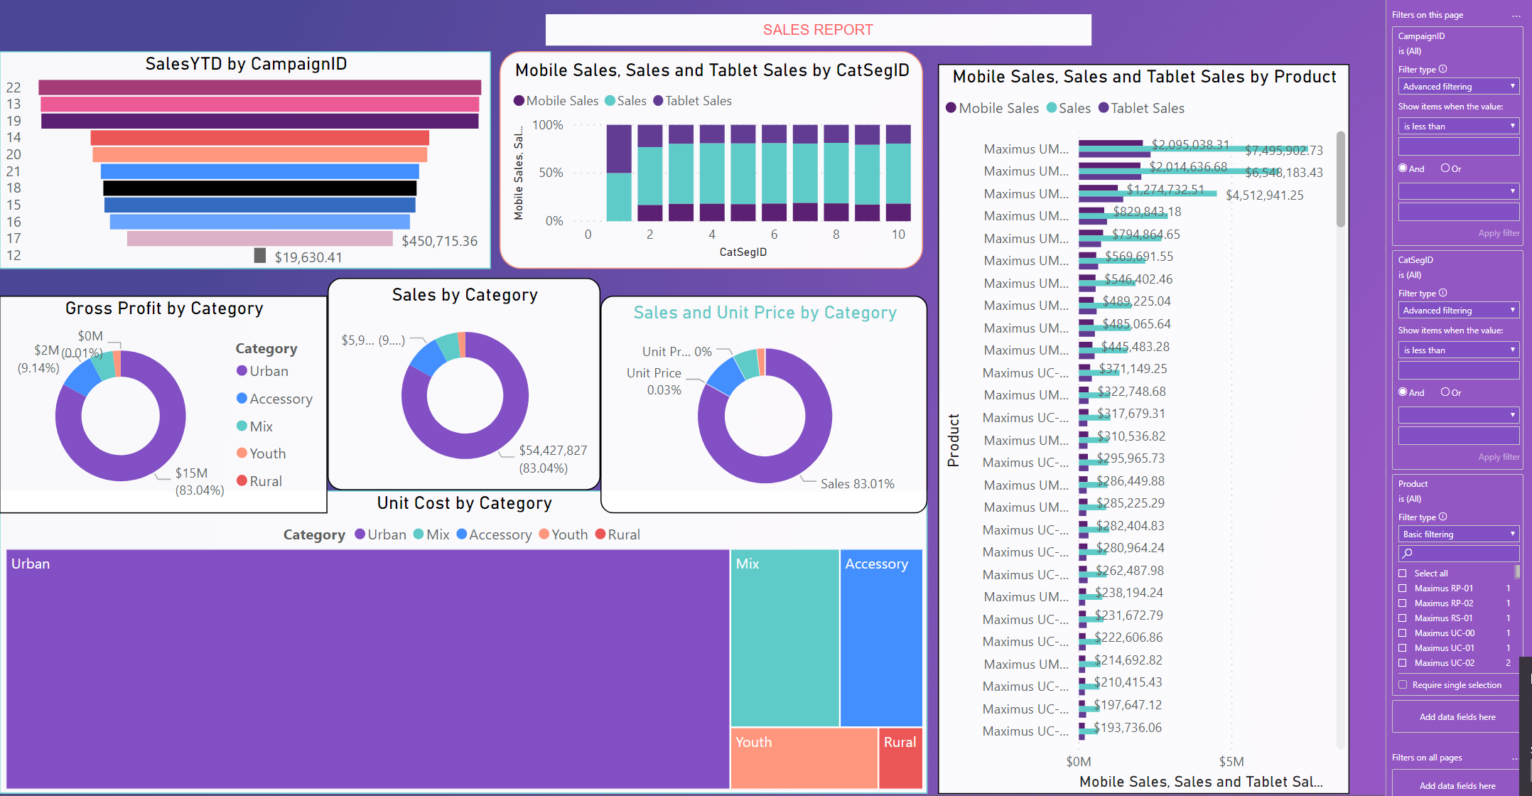
What is Story Telling with Data
We see reports everyday that share a common problem
© 2021 Microsoft. All rights reserved.

Slide 7
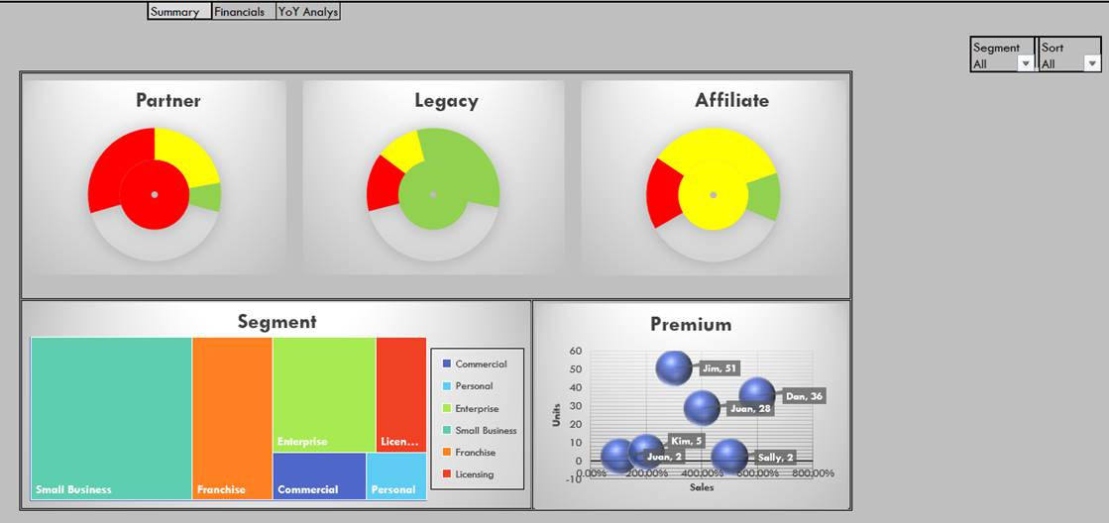
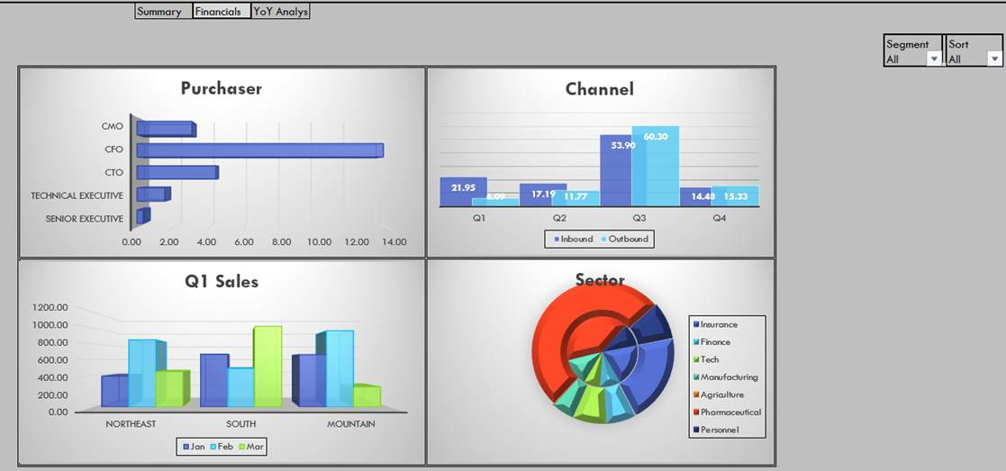
What is Story Telling with Data
We see reports everyday that all have the same problem
No story, so the visual does not stick
3 D Layering and Drop shadows - Eye sore
Color scheme, fonts, end up making you look like you are from 1990s
Use of incorrect charts
© 2021 Microsoft. All rights reserved.

Slide 8
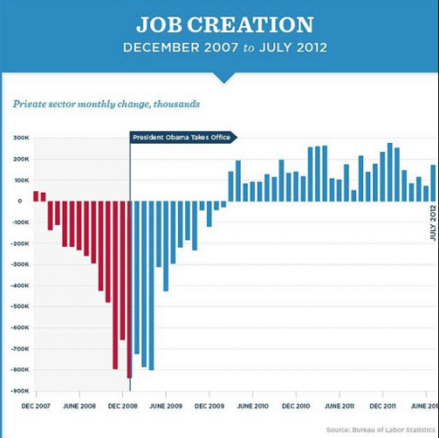
What is Story Telling with Data
Are there visuals and reports that tell a great story?
For a visual to work, it needs to tell the story the author intended.
Source: Bureau of Labor Statistics | Nathan Yau
© 2021 Microsoft. All rights reserved.

Slide 9
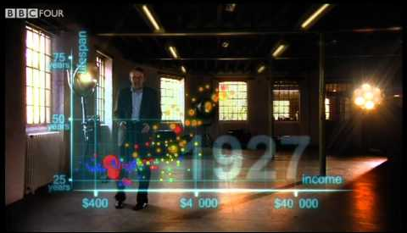
What is Story Telling with Data
Are there other ways to tell a great story with data?
Source: The Gap minder foundation, BBC, Youtube.com
Image Source: http://img.youtube.com/vi/jbkSRLYSojo/0.jpg
© 2021 Microsoft. All rights reserved.

Slide 10
Power BI Data Visualization in a Day
Module 2
The Science Behind Data Visualization

Slide 11
The Science Behind Data Visualization
Bad or “forgettable” reports all have the same problems…
No context
Excessive precision
Incorrect measures
Incorrect graph selection
Clutter
Inaccurate encoding of data
Poor layout
None or poor highlighting
Unnecessary pictures
Bad use of colors
How many of these problems can you spot in the example?
© 2021 Microsoft. All rights reserved.

Slide 12

Science Behind Data Visualization
To build great visualizations you have to understand Cognitive science
Visual memory system takes up 70% of all sensors in brain
Iconic memory
Short Term memory
Long Term memory
© 2021 Microsoft. All rights reserved.

Slide 13
Science Behind Data Visualization
How does information pass from one part of memory to another
Iconic memory
Short Term memory
Long Term
Memory
© 2021 Microsoft. All rights reserved.

Slide 14
Iconic Memory
Iconic Memory
Iconic memory
Short Term memory
Long Term
Memory
Can take large volumes of data
Lasts only a fraction of a second
99% of information discarded unless useful
Only “interesting data” is passed to Short Term Memory
© 2021 Microsoft. All rights reserved.

Slide 15
Iconic Memory
Spark the Iconic Memory – Mute the background noise
Things that can distract
Bright colors all over the report
Thick borders every where
Grid lines
Too much precision with numbers
No highlights
© 2021 Microsoft. All rights reserved.

Slide 16
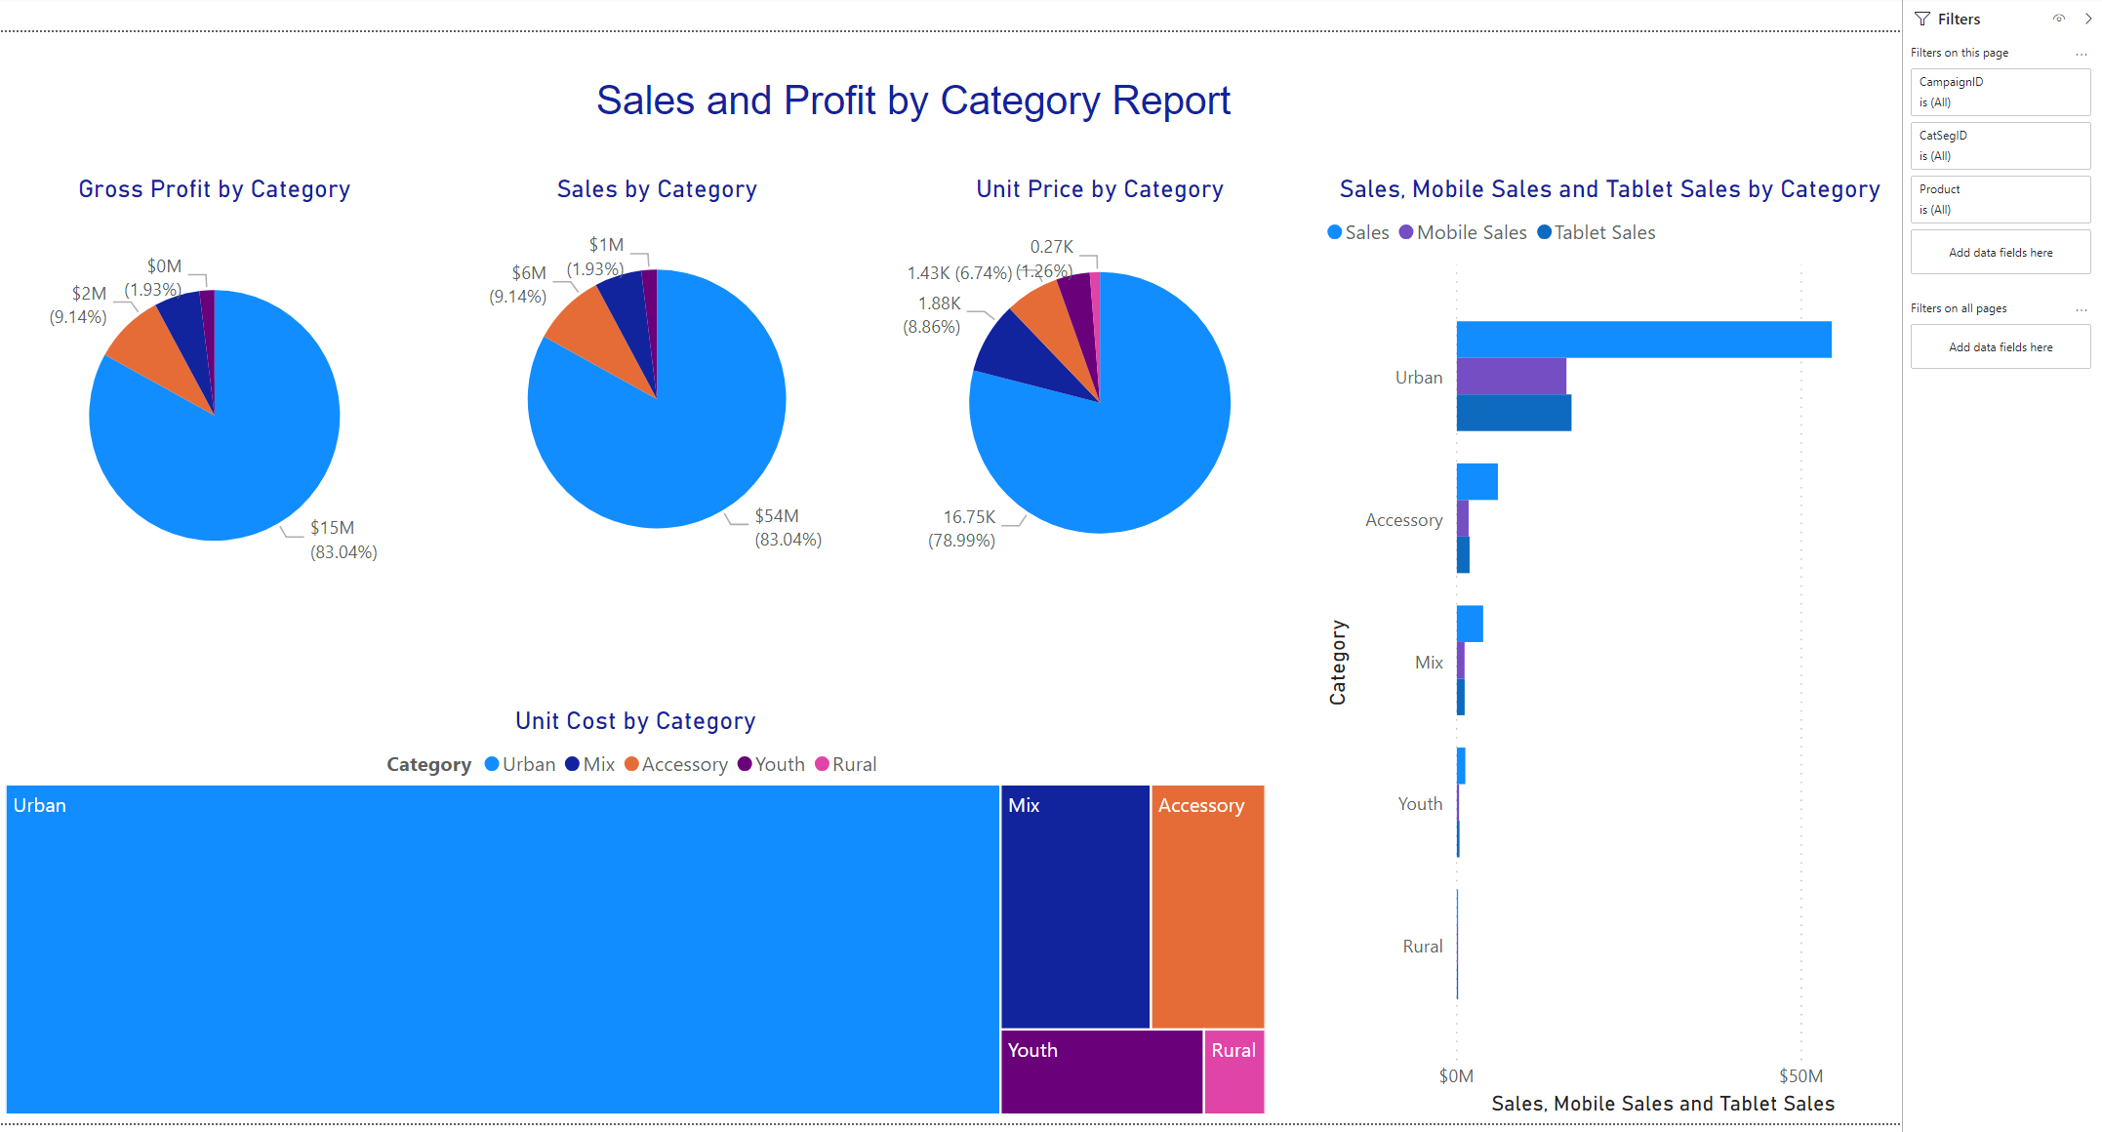
Iconic Memory
Spark the Iconic Memory – Mute the background noise
Things that can distract
Bright colors all over the report
Thick borders every where
Grid lines
Too much precision with numbers
No highlights
© 2021 Microsoft. All rights reserved.

Slide 17
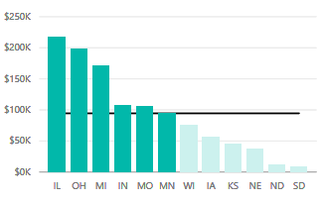
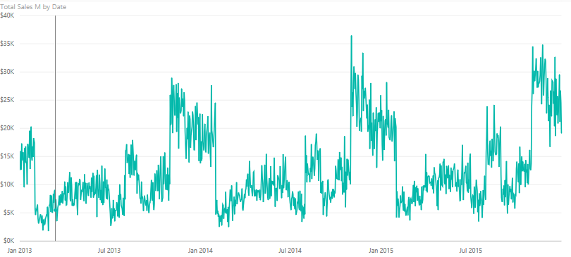
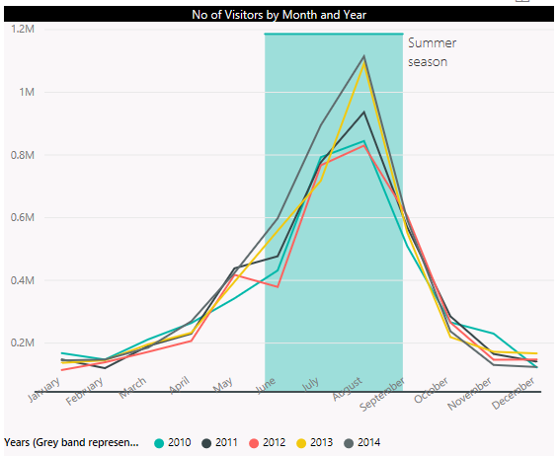
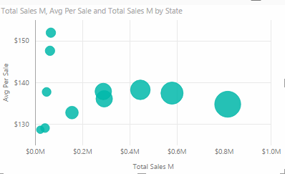

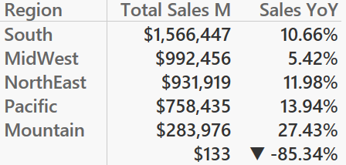
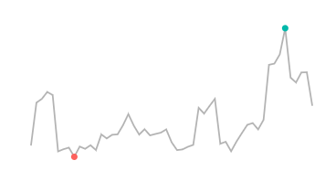
Iconic Memory
Spark the Iconic memory – Precognitive attributes
Very Precise Quantitative Perception: Length and 2D Positioning
Not Very Precise Quantitative Perception: Width, Size, Intensity, Blur
No Quantitative Perception = Orientation, Shape, Enclosure, Added Marks
© 2021 Microsoft. All rights reserved.

Slide 18
Iconic Memory
Spark the Iconic memory – Shapes
Shape size perception: the pie chart
Not Very Precise Quantitative Perception: Width, Size, Intensity, Blur
No Quantitative Perception = Orientation, Shape, Enclosure, Added Marks
© 2021 Microsoft. All rights reserved.

Slide 19
Short Term Memory
Lasts only a few seconds
Can take in 3 to 5 pieces of info at most
Memory tries to form these 3-5 pieces using patterns it detects in data
If these pieces of info do not have a story the data will not pass to Long Term Memory
Short Term Memory
Iconic memory
Short Term memory
Long Term
Memory
© 2021 Microsoft. All rights reserved.

Slide 20
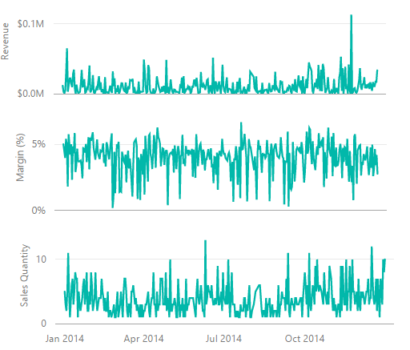
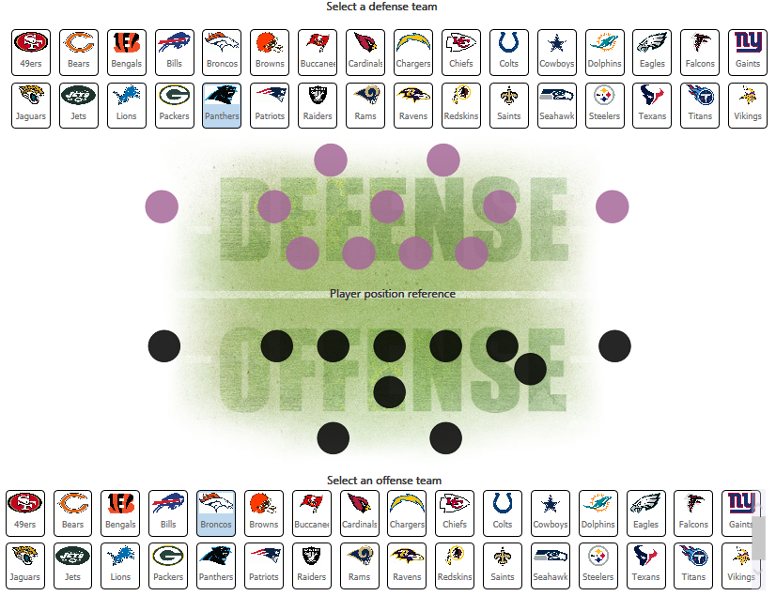
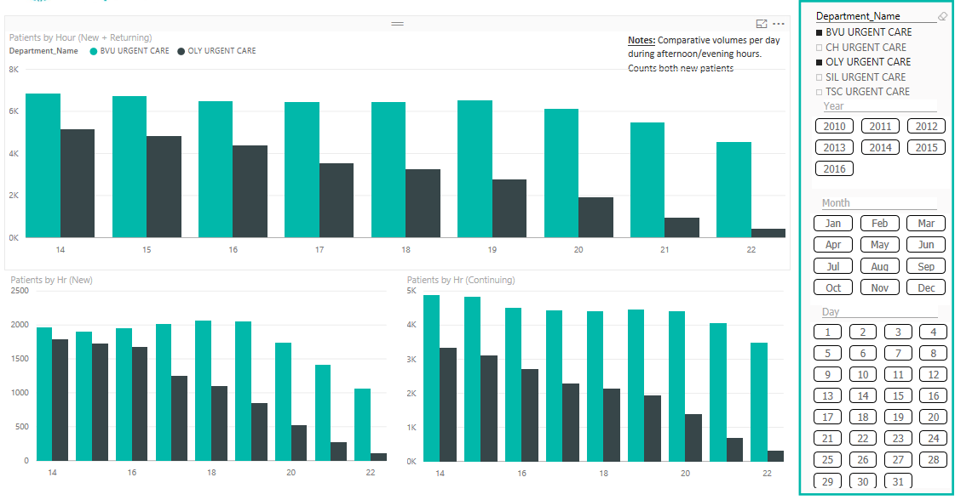
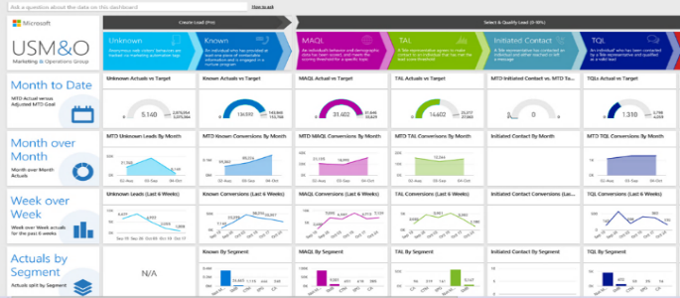
Short Term Memory
Spark the Short Term Memory – Gestalt’s principles
Proximity
Similarity
Figure & Ground
Continuity
Enclosure
Symmetry
Continuity
Symmetry
Based upon Gestalt’s Principles
© 2021 Microsoft. All rights reserved.

Slide 21
Long Term Memory
Long Term Memory
Iconic memory
Short Term memory
Long Term
Memory
Lasts for a long time
Data needs to be in long term memory to induce decision making
© 2021 Microsoft. All rights reserved.

Slide 22
Long Term Memory
Sparking Long Term Memory
Have a clear call for action
Use Pre-cognitive Techniques to Spark Interest
Use Gestalt’s principles of Data Pattern
Connect dots using Text/Audio to tell a story
© 2021 Microsoft. All rights reserved.

Slide 23
Module 2 Knowledge Check https://aka.ms/PBIVisCheckMod2

Slide 24
Power BI Data Visualization in a Day
Module 3
The Process Behind Data Visualization

Slide 25
Data Structure and Data Grain
Think Agile!!
Top 6 Questions to answer
Learn about your audience needs
Who? What? When? Where? How Many? Why?
Rapid
Prototype
Start Visuals with Sample Data
User feedback
Use Whiteboard or Storyboard to plan POC
Build visuals in tool
User feedback
© 2021 Microsoft. All rights reserved.

Slide 26
Convert the Story to a Date Model
List your big questions:
What is my Total Sales for a Selected Year and Region?
How is my Total Sales doing Year Over Year?
How are my Units trending for various States in my region?
How is my Sales doing by Channel, Device, Category for selected Year?
Which categories are performing best to worst by Total Sales ?
Units
Total Sales
Gross Profit
These are Measures which live in Fact tables
What are you measuring?
By Time (Year, Month)
By Geography (Region, State or City)
By Campaign (Channel or Device)
These are Attributes that live in Dimension tables
How are you describing or slicing?
© 2021 Microsoft. All rights reserved.

Slide 27
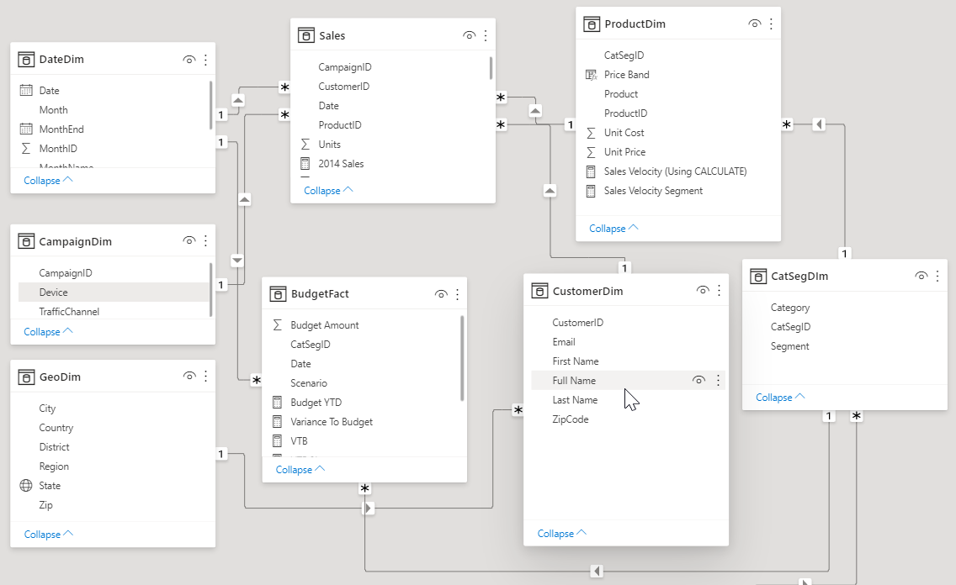
Convert Story to a Data Model
Dim
Fact
Dim
Dim
Measures (e.g. Units or Sales) live in fact tables
Descriptive attributes (e.g. Campaign, Customer name) live in dimension tables
Relationships tie the data together so you can slice your measures by your attributes
Relationship
Relationship
© 2021 Microsoft. All rights reserved.

Slide 28
Module 3 Knowledge Check https://aka.ms/PBIVisCheckMod3

Slide 29
Power BI Data Visualization in a Day
Module 4
Dashboards and Reports

Slide 30
Terminology and Definitions
A Power BI dashboard is a single page, often called a canvas, that uses visualizations to tell a story. Because it is limited to one page, a well-designed dashboard contains only the most-important elements of that story.
Workspaces are containers for dashboards, reports, workbooks, and datasets in Power BI Service. There are two types of workspaces: *My workspace and app (group) workspaces.
A Power BI report is a multi-perspective view into a dataset, with visualizations that represent different findings and insights from that dataset. A report can have a single visualization or pages full of visualizations.
Goals are a data driven way to let users curate metrics and track them against key business objectives. Teams can measure progress against their goals, proactively share updates with their teammates, and dive deeper into their data when something needs further analysis.
© 2021 Microsoft. All rights reserved.

Slide 31
Datasets, Reports, Dashboards (in Service)
No Dashboard Report is directly shared with users
Executive
Dashboard
Summary Dashboard
Project Orion
Dashboard
Project Draco
Dashboard
Project Pisces
Dashboard
Published from PBIX
Subscription Report
Web Report
Audit Report
Telemetry Report
Project Orion Report
Project Draco Report
Project Pisces
Report
Subs.
Data
Set
Web Data Set
Telemetry Data
Set
Orion
Data
Set
Draco
Data
Set
Pisces
Data
Set
Example 1
Example 2
Example 3
Data sets contain the Data Model with tables (created by Power Queries) with relationships and DAX calculations.
The same Data set can be used to build multiple reports
A report can only be built from 1 data set
A Dashboard can be built from multiple reports and/or multiple dashboards
© 2021 Microsoft. All rights reserved.

Slide 32

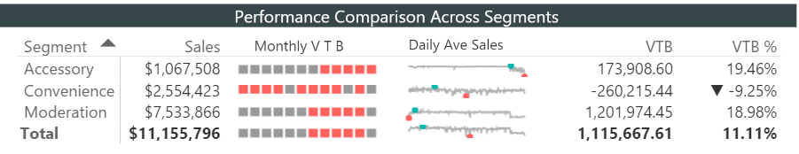
Layouts – Dashboard vs Report
Dashboard Layout
Report Layout
Typically provides snapshot of business overview and may contain data from multiple reports
Typically answers 1 business question
© 2021 Microsoft. All rights reserved.

Slide 33
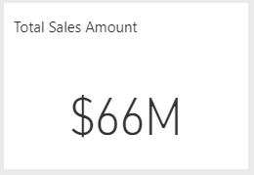
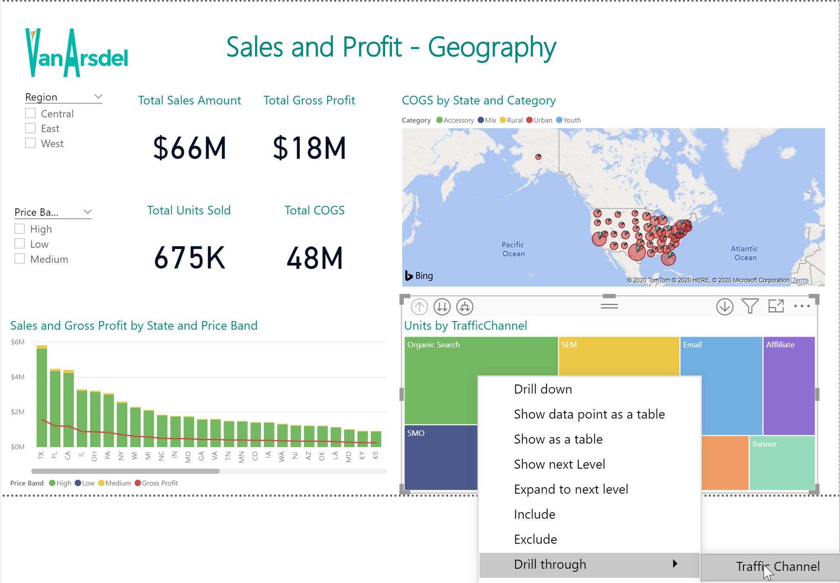
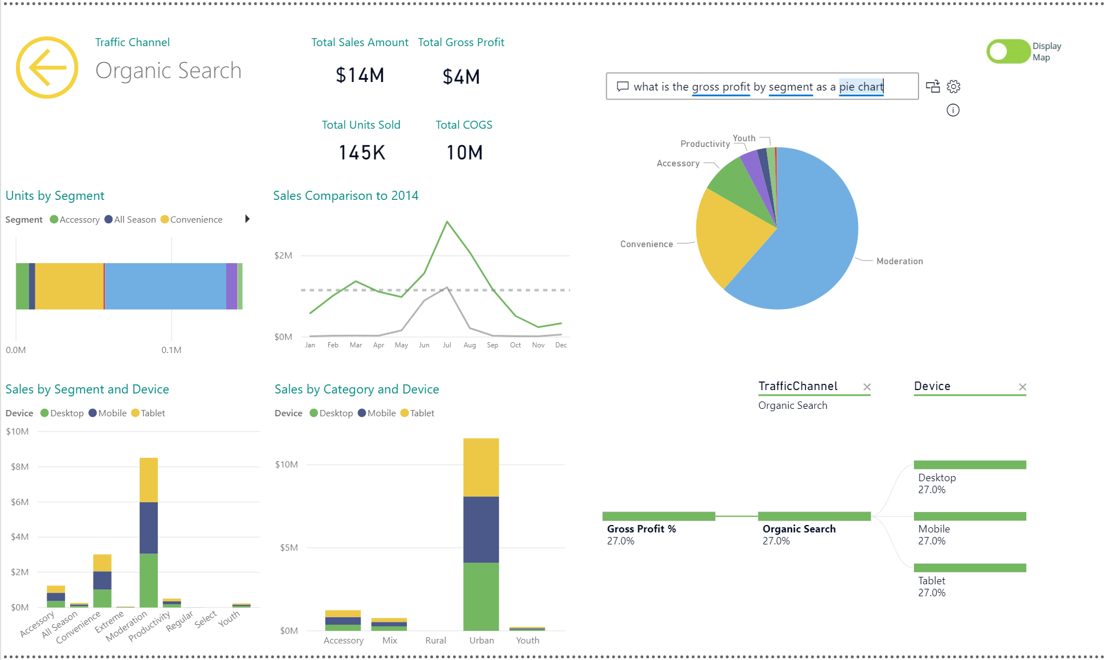
Dashboard to Report Transitions
Dashboard Tile (single KPI) Action Oriented – click thru to report
Report – tell top level story of KPI
* Drill to another report (sliced to specific details)
In a report you can use “Back” to navigate back up
© 2021 Microsoft. All rights reserved.

Slide 34
Layouts
Most people’s attention drawn here
2nd most important area
Most people’s attention drawn here
3rd most important area
Least important area
© 2021 Microsoft. All rights reserved.

Slide 35
Power BI Data Visualization in a Day
Dashboards – Layout & Structure

Slide 36
Column Layouts
Title
Area 1
Title
Area 2
Title
Area 3
What is this layout most suitable for?
1st KPI
Area 1
1st KPI
Area 2
1st KPI
Area 3
2nd KPI
Area 1
2nd KPI
Area 2
2nd KPI
Area 3
Chart
Area 1
Chart
Area 2
Chart
Area 3
© 2021 Microsoft. All rights reserved.

Slide 37
Dashboard Layouts – Vertical Matrix Layout
Layout is useful when
Each row has a story
Each column has similar KPIs
Usually helpful in Marketing, Supply Chain (think conversion funnels etc.)
© 2021 Microsoft. All rights reserved.

Slide 38
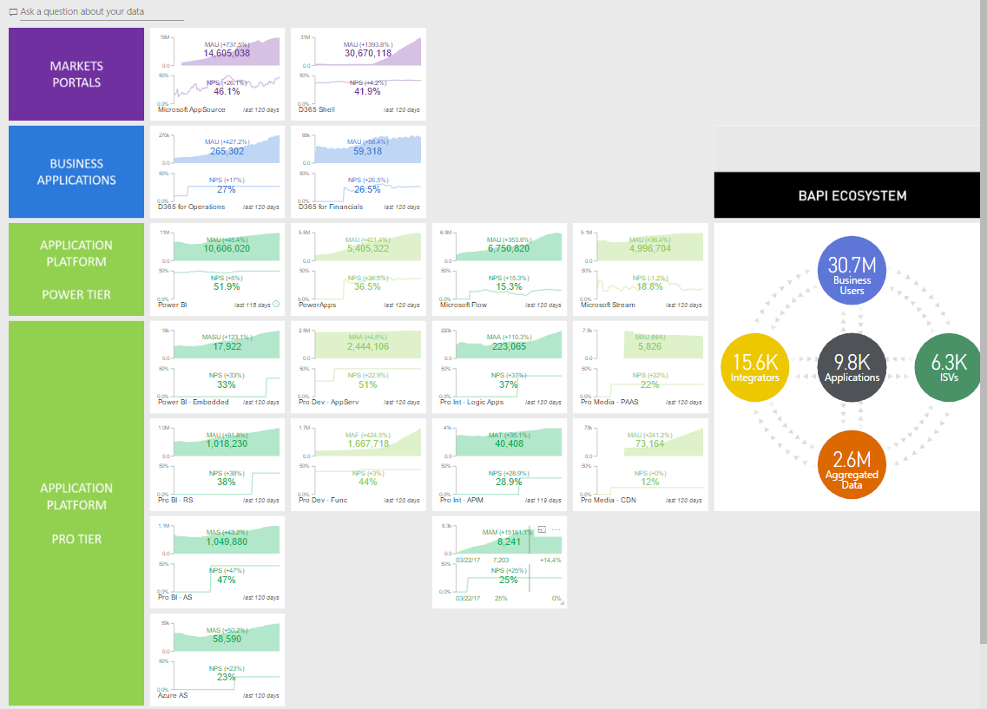
Dashboard Layouts – Horizontal Matrix
This dashboard is currently in use by Microsoft to manage their cloud business.
https://powerbi.microsoft.com/en-us/blog/how-microsoft-uses-power-bi-to-run-its-growing-cloud-business/
© 2021 Microsoft. All rights reserved.

Slide 39
Power BI Data Visualization in a Day
Reports – Layout and Structure

Slide 40
Use Storyboarding to Design Report Layout
Slicers
Logo Subject
When?
Who?
Where?
What?
Control this space. If all objects tell the same story, use the same gap space. If some objects tell a different story, make the gap bigger
© 2021 Microsoft. All rights reserved.

Slide 41
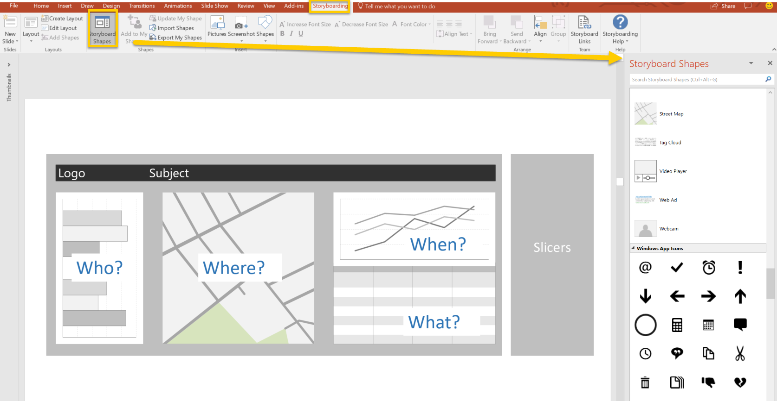
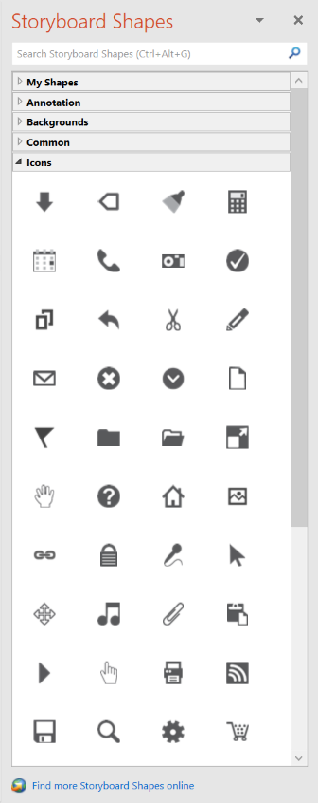
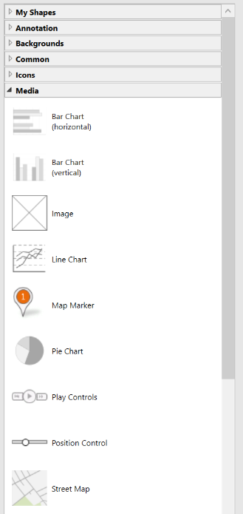
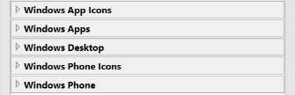
Storyboarding Tools
Install the Storyboarding Toolbar: https://docs.microsoft.com/en-us/vsts/work/backlogs/office/storyboard-your-ideas-using-powerpoint
© 2021 Microsoft. All rights reserved.

Slide 42

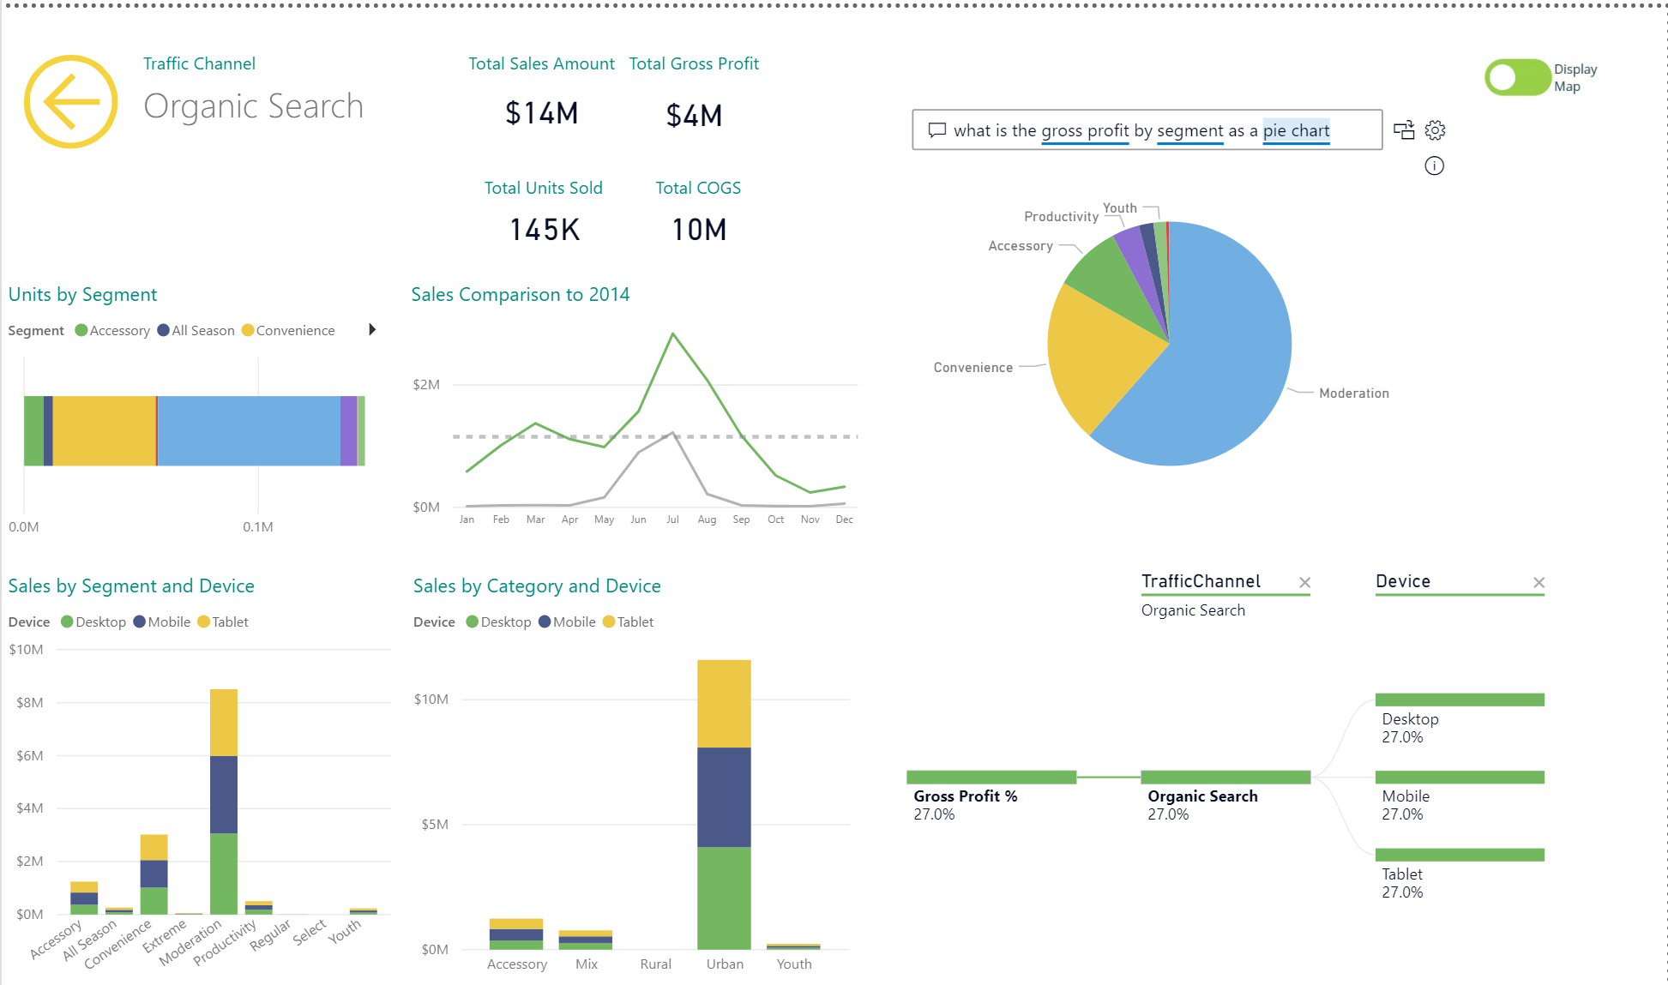
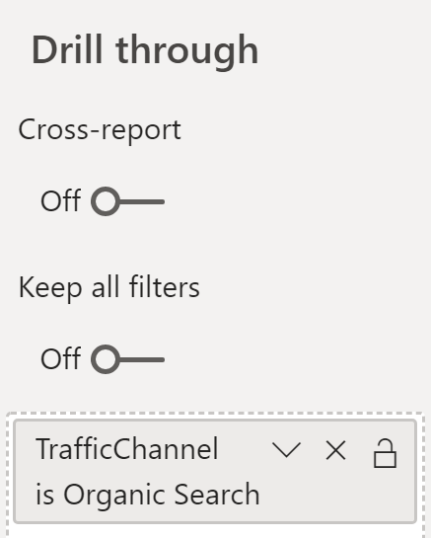
Report Channel – Drill Through Filters
Drill through allows you to create a page that provides details on a single ‘entity’ in your model:
Allows quick navigation to a report page for more depth on that entity
Can be accessed by almost any visual which contains that entity
Quick “Back” button that is functional in Power BI Service as well
© 2021 Microsoft. All rights reserved.

Slide 43
Demo 4a

Slide 44
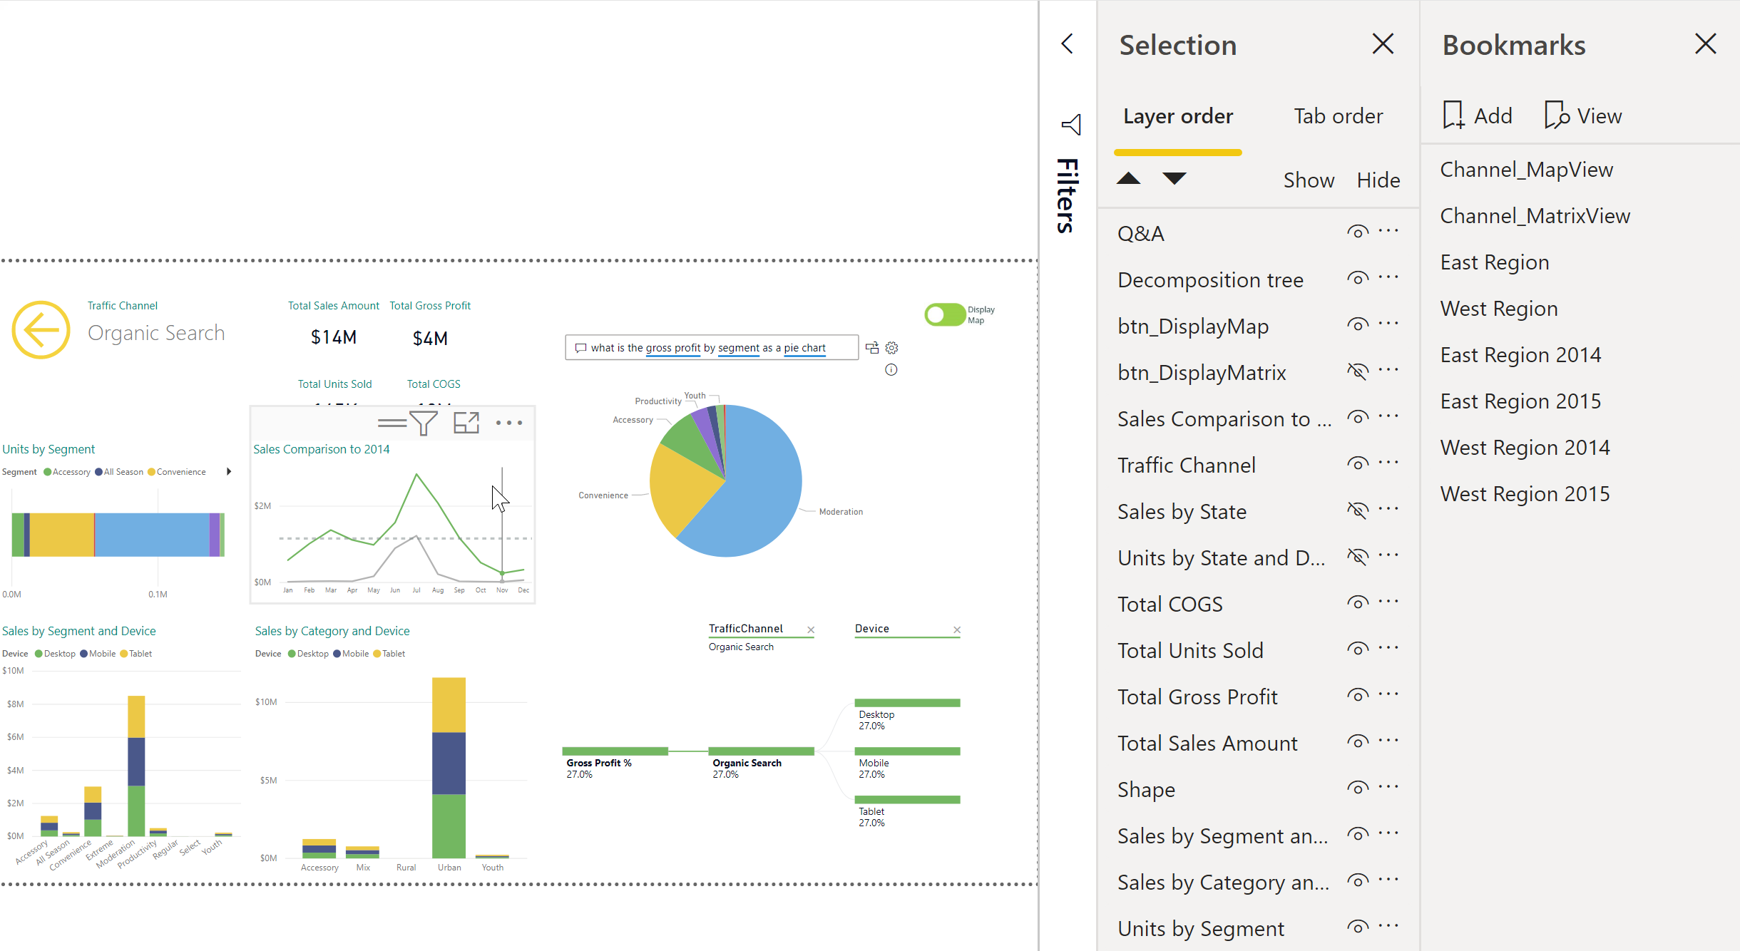
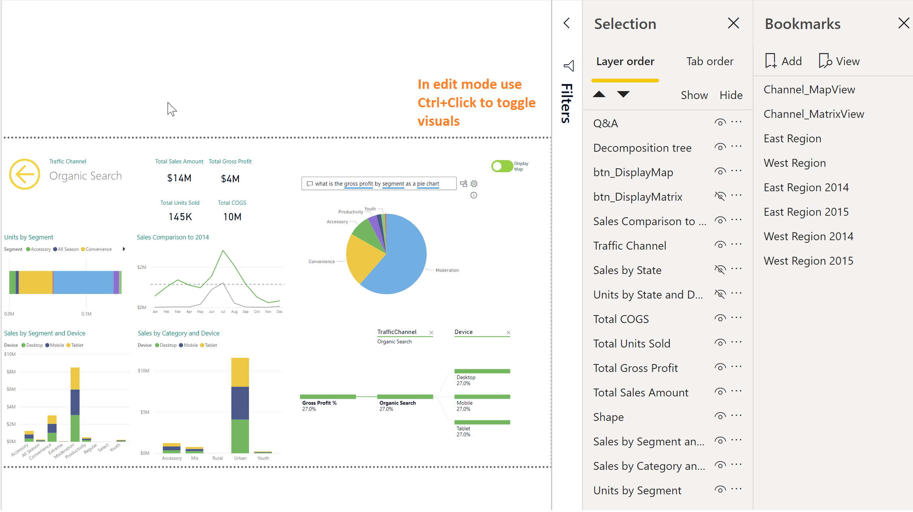
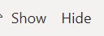
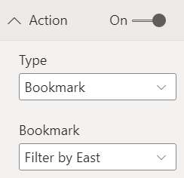
Report Channel – Bookmarks and Toggles
Bookmarks let you save interesting states as part of your report. Once you have a list of bookmarks, you can use these in several ways including organizing and transitioning visuals:
Includes the current page
Any filters and slicers selected
Sort Order
Which visuals should appear on the report
Use Selection pane to choose visuals for bookmarks
Manage Bookmarks on the Bookmark pane
Add creates bookmark
Update updates existing bookmark (…)
Assign bookmarks to images/shapes from the Format Pane – Link Section
Turn link ON
Type = Bookmark
Assign Bookmark name
© 2021 Microsoft. All rights reserved.

Slide 45
Demo 4b

Slide 46
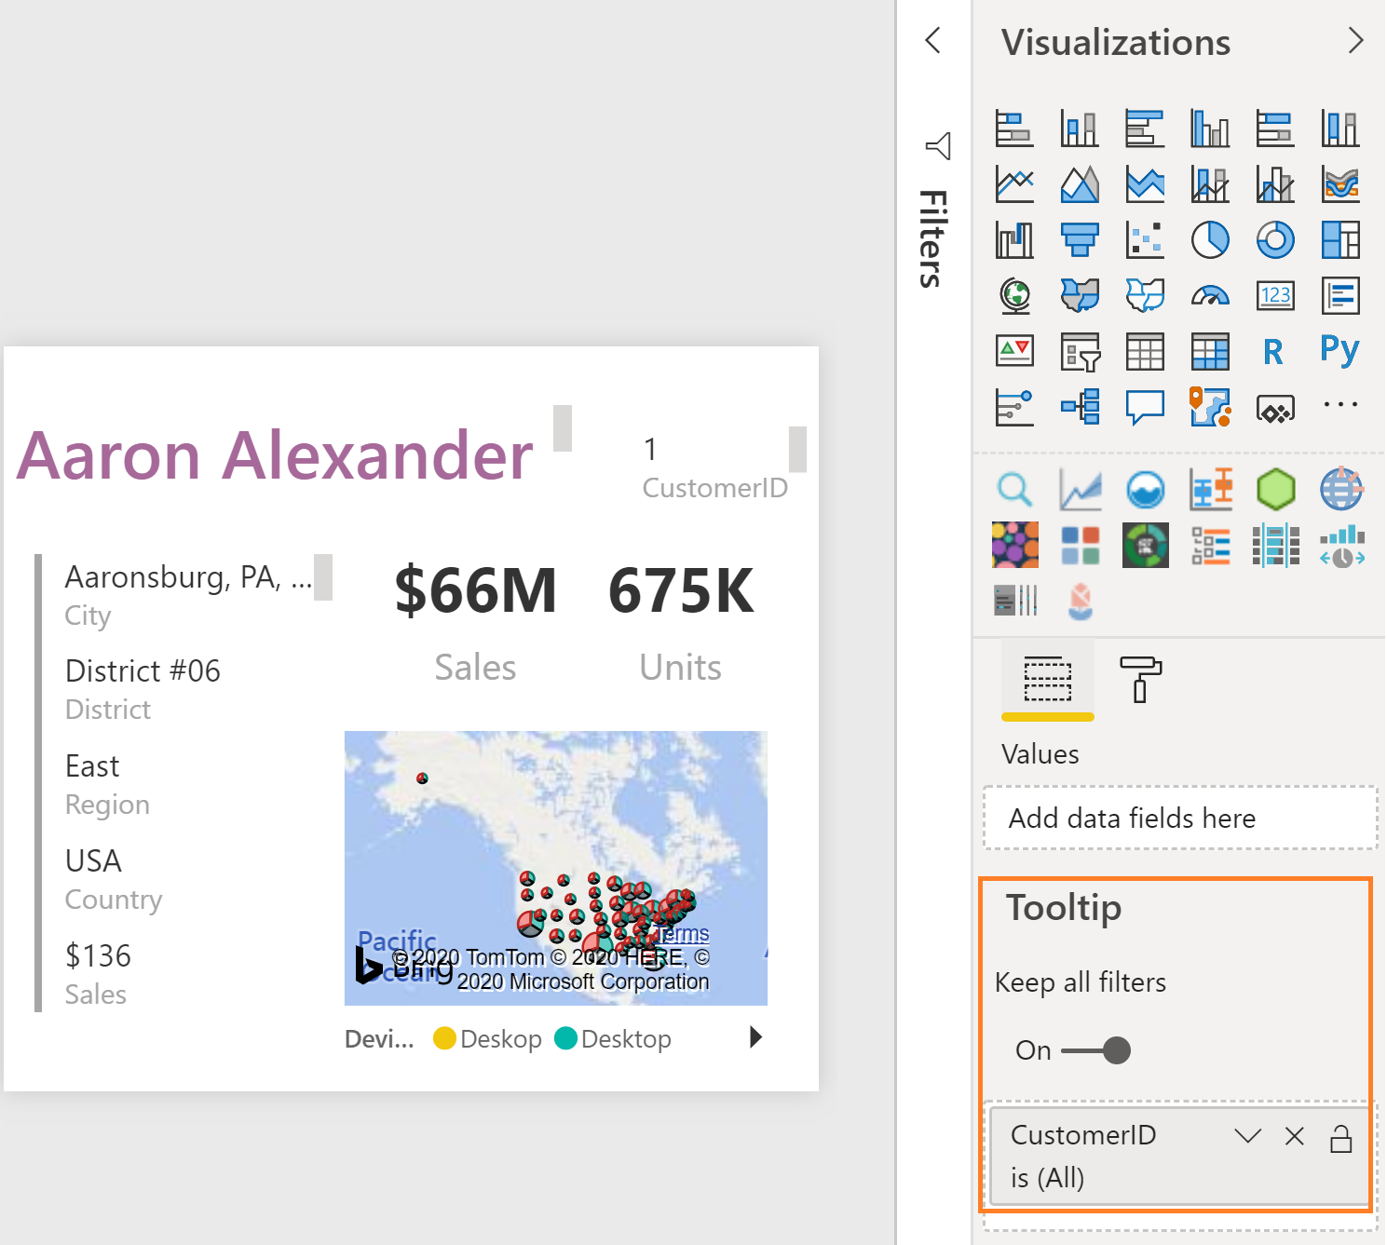
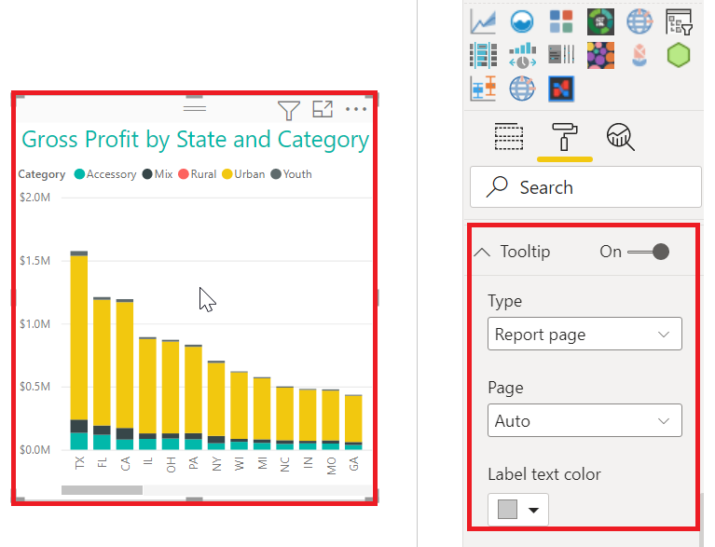
Create Custom Tooltip Report
Create a custom tooltip report for any field as a new page
Create the Tooltip Report
Page Information – enable Tooltip
Page Size – use Tooltip or set custom size
View Ribbon, set Page View to Actual Size
Place key Field in Tooltip Field Well
Does not work with the Matrix or Table visual (yet)
Assign the Custom tooltip to each chart for which you want the tooltip to appear – the field must be visible on the chart
You can Hide the tooltip (or any other) report!
Right click to hide
© 2021 Microsoft. All rights reserved.

Slide 47
Demo 4c

Slide 48
Slicers vs Filters Pane
Slicers | Filters Pane
Visible on the report canvas | Does not take up room on the canvas
Can by synced across report pages | Good when list of values is large
Good for touch screens | More advanced options
Can edit interactions with slicers | Better for performance
Good when lists are limited | Good if the value is used infrequently
Good if the value is used frequently | Cannot be pinned to a dashboard
Good if value needs to be seen quickly
Can be pinned to a dashboard
© 2021 Microsoft. All rights reserved.

Slide 49
Module 4 Knowledge Check https://aka.ms/PBIVisCheckMod4

Slide 50
Power BI Data Visualization in a Day
Module 5
Chart Selection

Slide 51
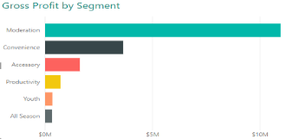
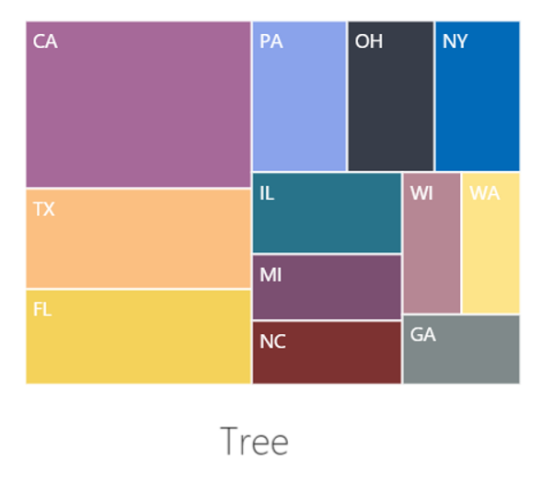
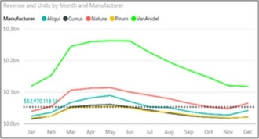
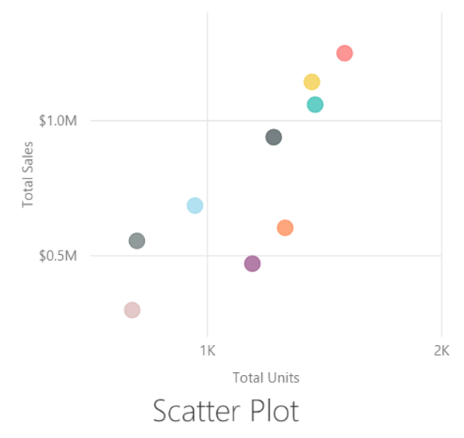
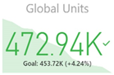
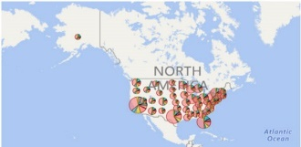
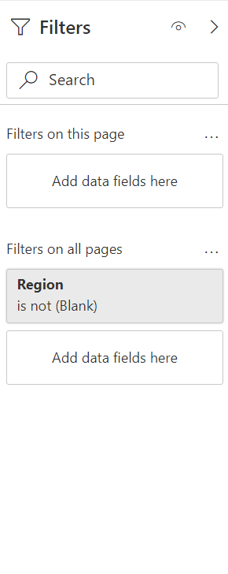
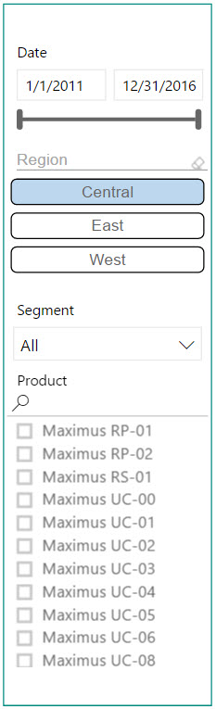
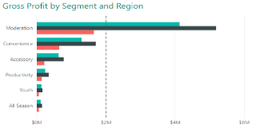
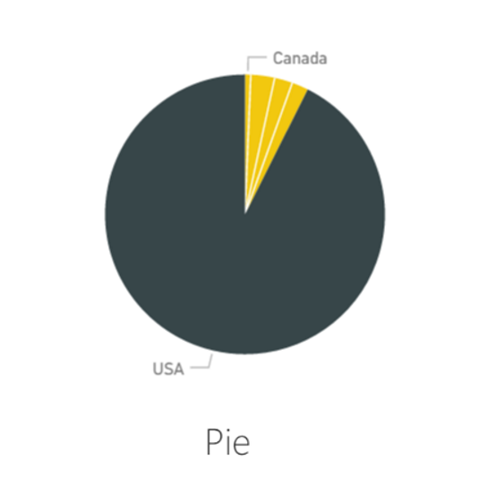
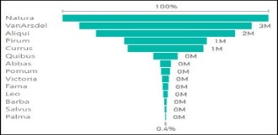
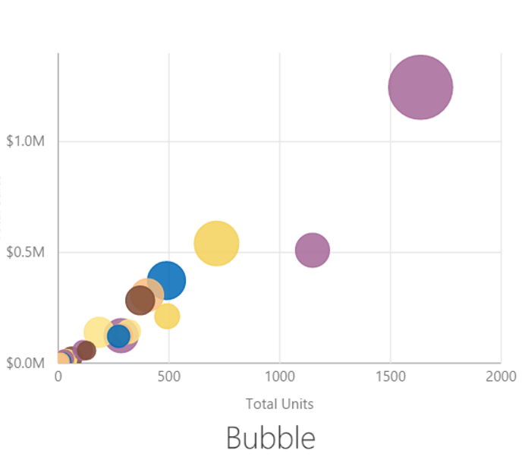
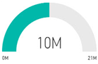
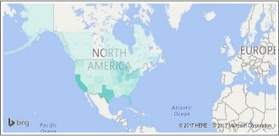
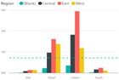
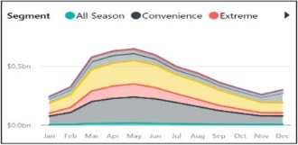










Choose the Right Charts for the Right Purpose
Comparison
Composition
Trend
Distribution
Status
Geographic
Relationships
Slicing/Filtering
Stacked Bar
Tree
Line
Scatter Plot
KPI
Map
Clustered Bar
Pie
Funnel
Bubble
Gauge
Filled Map
Clustered Column
Stacked Area
Line and Stacked Column
Map
Multi-row Card
Table
100% Stacked Column
Stacked Column
Area
Card
Matrix
Water Fall
Bubble
© 2021 Microsoft. All rights reserved.

Slide 52





Column Charts for Comparison
Start Axis at 0
Sort Chart
Try to Have a Reference Line
Use colors to draw attention
© 2021 Microsoft. All rights reserved.

Slide 53


Column Chart vs Bar Chart for Comparison
When you have too many elements to display in a column, the bar chart can be easier to scroll.
© 2021 Microsoft. All rights reserved.

Slide 54


Line Charts
Start axis based on your “business scenario”
Choose the right aspect ratio
Try to have a reference line
Use colors to draw attention strategically
Decide whether to “Show items with no data”
Data can be misleading if the breaks are connected
In the formatting pane, change the axis to categorical from continuous
© 2021 Microsoft. All rights reserved.

Slide 55



Area Chart vs Line Chart
Choose area charts sparingly (when # of series < 5)
Too many colors can be distracting
Often line charts are the better option
Would a line chart better portray my meaning?
Is the area the meaningful thing I am measuring?
© 2021 Microsoft. All rights reserved.

Slide 56
Stacked Area Charts
Used to show how proportions and totals are changing
Choose this chart wisely
Can lead to misleading conclusions
The eye tends to interpret the trends using the top lines of each shaded region rather than using the area of each region
© 2021 Microsoft. All rights reserved.

Slide 57

One Use Case for Area Charts
To see when a trend goes above or below a reference line
© 2021 Microsoft. All rights reserved.

Slide 58



Stacked vs Clustered Column (Bar) Chart Types
Shows totals
Shows part to whole relationship
Inter-category comparison
Intra-category comparison
Shows Mix% change
Ignore absolute numbers
© 2021 Microsoft. All rights reserved.

Slide 59


Constructing Effective Tree Maps
Tree map is useful to visualize proportions
Use Drill down to allow navigation to detail
© 2021 Microsoft. All rights reserved.

Slide 60



Constructing Effective Pie Charts
Do not have more than 3-5 categories (if you have more then put a slicer and choose a default)
Have data labels
Choose right sort order
Choose appropriate colors
Pie chart is widely used but is not a recommended visual because we can’t intuitively understand the segment size
Bad Pie chart
Good Pie chart
© 2021 Microsoft. All rights reserved.

Slide 61



Constructing Effective Tables
Reduce precision
Use muted background color
Choose the right font size
Use white space for columns instead of borders
Highlight items using symbols
Sort table based on key KPIs
© 2021 Microsoft. All rights reserved.

Slide 62



Constructing Effective Cards
Category labels can be renamed on each visual
Choose right precision levels
Use colors to draw attention to KPIs that matter most
Use KPIs in conjunction with symbols to draw attention
© 2021 Microsoft. All rights reserved.

Slide 63




Constructing Effective Slicers
Slicer as List
Date slicer
Enclose slicers using a subtle box
Group slicers together and keep them on the same side of page
Conserve space by using dropdown slicers
Use “Chiclet Slicers” for a different look
When slicing dates, use the Date slicer
Numeric slicer
Chiclet slicer
Chiclet slicer
Slicers as
dropdown
© 2021 Microsoft. All rights reserved.

Slide 64

Constructing Scatterplot Charts
Used to see distributions of 2 or more variables
Use hierarchies
Helps to identify outliers
Useful for categorization or clustering
Time axis used to show changes over time
Choose colors wisely
© 2021 Microsoft. All rights reserved.

Slide 65
Power BI Data Visualization in a Day
Module 5 Labs
Lab 5a: Update a column chart
Lab 5b: Format a column chart
Lab 5c: Conditional formatting
Lab 5d: Decomposition tree and Q&A
Lab 5e: Working with small multiples

Slide 66
Power BI Data Visualization in a Day
Module 6
Accessibility and Custom Visuals

Slide 67
Report Accessibility Checklist
Turn on markers and use different markers for each line
Don't rely on color or conditional formatting to provide insights, use data labels/graphics/shades
Pick an intentional sort order for each visual on your report (LTR or RTL)
Select a theme that is high contrast and color blind friendly
Ensure contrast between text and background
Use text sizes and fonts that are easily readable
Include a title, axis labels, and data labels in all visuals
Use meaningful titles for all report pages
© 2021 Microsoft. All rights reserved.

Slide 68
Report Accessibility – Built-in Features
Built-in accessibility features
Keyboard navigation
Screen-reader compatibility
High contrast colors view
Focus mode
Show data table
© 2021 Microsoft. All rights reserved.

Slide 69
Report Accessibility – Configurable Built-in Features
Built-in accessibility features requiring configuration
Alt text
Tab order
Titles & labels
Markers
Report themes
© 2021 Microsoft. All rights reserved.

Slide 70

Power BI Customizations
Import Custom Visual
Click the ellipsis on the Visualization menu
Get more visuals
Select the visual to download
Use the visual
If you decide you don’t like it – delete it
© 2021 Microsoft. All rights reserved.

Slide 71

Power BI Customizations
Custom Visual Gallery
© 2021 Microsoft. All rights reserved.

Slide 72

Power BI Customizations
Custom Visuals
250+ Custom visuals available from AppSource
R and Python Integration
3rd Party Tools
Tools to develop, test, package new custom visuals
© 2021 Microsoft. All rights reserved.

Slide 73

Power BI Customizations
Create Custom Visual
© 2021 Microsoft. All rights reserved.

Slide 74

Custom Slicers
© 2021 Microsoft. All rights reserved.

Slide 75
Demo 6a

Slide 76

Power BI Customizations
Create Custom Visual Using R Visual
Visuals can be created in R and Python
© 2021 Microsoft. All rights reserved.

Slide 77
Demo 6b

Slide 78


Power BI - Charticulator
Interactive and Reusable Chart Creation
Charticulator lets you export chart designs into reusable templates for Microsoft Power BI custom visuals
© 2021 Microsoft. All rights reserved.

Slide 79
Power BI Data Visualization in a Day
Module 6 Labs
Lab 6a: Adding a custom visual
Lab 6b: Add report accessibility

Slide 80
Power BI Data Visualization in a Day
Module 7
Publishing and Formatting

Slide 81
Demo 7 - Formatting

Slide 82
Colors
How do you pick a color scheme?
Check with your Marketing team for color/style guides
Use Cynthia Brewer’s Color Brewer or other sites to choose colorblind friendly colors
Use the Adobe Color Wheel to get custom complementary colors
Paletton.com is the color scheme generator that the Power BI product team uses
Colorblind Sensitive: Contrast Analyzer is a tool you can use that creates a “lens” to see how people with visual disabilities would view your reports: https://developer.paciellogroup.com/resources/contrastanalyser/
Use Power BI’s default color scheme
© 2021 Microsoft. All rights reserved.

Slide 83


Things to Remember when Using Colors
Do not have more than 3-5 colors display on a single visual (think of Short-Term memory)
The eye cannot differentiate more than 5 colors of same hue
Try to have a semantic meaning for your colors (Red = Bad, Green = Good)
© 2021 Microsoft. All rights reserved.

Slide 84



Make Your Own Theme
Theme files are simple JSON files
Import the theme into your PBIX to update styles in your report
Color palette
Font
Visual formatting (and more…)
Check out pre-made themes in the Power BI Theme Gallery
Blog post on how to apply themes: https://powerbi.microsoft.com/en-us/blog/power-bi-community-report-theme-gallery/
Theme Generator: https://powerbi.tips/tools/report-theme-generator-v3/
© 2021 Microsoft. All rights reserved.

Slide 85
Font
Two Font Types
Serif
Sans-Serif
Monospace
Informal
Monospace
Informal
Sans-Serif fonts most suited for digital media in a professional setting
Ex. Segoe, Calibri, Trebuchet
© 2021 Microsoft. All rights reserved.

Slide 86
Changing Font Weight using three Techniques
Change font size
Hi Power BI - Segoe UI Light 28
Hi Power BI - Segoe UI Light 24
Choose different font with greater weight from same family
Hi Power BI - Segoe UI (Body) 24
Hi Power BI - Segoe UI Light 24
Bold an existing font
Hi Power BI - Segoe UI Light 24 (Bolded)
Hi Power BI - Segoe UI Light 24 (Non-Bolded)
Try all three techniques to see which one looks the best
© 2021 Microsoft. All rights reserved.

Slide 87
Font Recommendations
Choose at the most 2-3 font types/sizes on a report page/dashboard
Choose a lighter weight font Ex. “Segoe UI Light” for
Axis
Non important Data Labels
Text box
Non-Titles
Use a higher weight font from same family for titles rather than (bold) Ex. Segoe UI Bold
© 2021 Microsoft. All rights reserved.

Slide 88

Use of Fonts
© 2021 Microsoft. All rights reserved.

Slide 89
Icons
Effective use of icons can add to perceptual depth of a report
Don’t over use icons or misuse icons
© 2021 Microsoft. All rights reserved.

Slide 90

Dashboard Tile Art
Rectangle image size 1.81” by 2.66”
Add header text
Add subtitle text
Add circle shape for icon emphasis
Add icon from native Office 2016 Icon library
Change color of icon graphic
Snip out the box and save as PNG
Month to Date
MTD Actual vs MTD Goal
© 2021 Microsoft. All rights reserved.

Slide 91
Proportional Sizes for Custom Dashboard Tiles
1 x 1 Tile – 266:181 pixels
2 x 1 Tile – 540:181 pixels
3 x 1 Tile – 816:181 pixels
Rule of Thumb Formula:
Images Width = 266 * (Number of Tiles Wide)+ 8 (Number of Tiles Wide – 1)
Image Height = 181 * (Number of Tiles High)+ 8 (Number of Tiles High– 1)
Pro Tip: Tile sizes don’t have to be exact, just proportional (i.e. 2.66” by 1.81”)
© 2021 Microsoft. All rights reserved.

Slide 92


Symbols
⇙
▼
⚠
➕
✔
⚐
★
◕
Different Ways to Use Symbols
Unicode Symbols - You can find unicode symbols at Unicode-table.com or Unicode.org (need to convert hex to dec) (rendered in Black/White)
Locate the web page for the desired symbol
Scroll down to see the “Your Browser” section
Highlight the symbol and copy ( Ctrl+C )
Paste ( Ctrl+V ) into the formula bar of your DAX
© 2021 Microsoft. All rights reserved.

Slide 93

KPIs
Different Ways to Obtain/Use KPIs
Use the KPI visualization in Power BI Desktop
If you import an Excel data model with KPIs into Power BI Desktop, the KPIs will be maintained and render in color
If you connect Power BI Desktop to either SSAS Multi-Dimensional or Tabular Model which contains KPIs, the KPIs will render in color in your visualizations
In the Table Visual, use conditional formatting to set colors in a column then set the column width very small to only display the colors
© 2021 Microsoft. All rights reserved.

Slide 94
Report Layout Hacks
Can this be done in Power BI?
© 2021 Microsoft. All rights reserved.

Slide 95


Bar Charts as KPIs
You can do the same with Pie Charts
© 2021 Microsoft. All rights reserved.

Slide 96



Spark Lines
Spark line with Min, Max
YoY growth with +/-
Win loss charts
How do you create these with Power BI?
© 2021 Microsoft. All rights reserved.

Slide 97


Hyperlinks and Images
Full path of the URL in a field
Modify the Data Category (modeling ribbon)
ImageURL – to see image
WebURL – to link symbol
Supports all link types displayed at left.
How do you create these with Power BI?
© 2021 Microsoft. All rights reserved.

Slide 98
Module 7 Knowledge Check https://aka.ms/PBIVisCheckMod7

Slide 99
Power BI Data Visualization in a Day
Module 7 Labs
Lab 7a: Product sales and geography
Lab 7b: Edit interactions
Lab 7c: Create a treemap
Lab 7d: Working with filters
Lab 7e: Sync slicers
Lab 7f: Bookmarks & action button
Lab 7g: Smart narrative visual
Lab 7h: Create a mobile layout

Slide 100
Power BI Data Visualization in a Day
Module 8
Sample Report Authoring Process

Slide 101
Power BI Reports - Design Thought Process
1. Empathize with your audience
1
2
3
4
5
Demographics - who are your users
Roles - what do the users want to achieve
Platforms - what is the consumption experience
Goals - what are the questions users want to answer
Experience - how do users explore the data
Pain points - what is the users main frustration

Slide 102
Power BI Reports - Design Thought Process
2. Define the platform environment
1
2
3
4
5
Service - Microsoft cloud-based app
Mobile – will users be accessing through mobile
Embedded - app development
Publish to web - blogs, websites, emails and social media
Paginated Reports - printing and electronic format
Mixed reality - augmented reality and mixed reality
2

Slide 103
Power BI Reports - Design Thought Process
3. Encompass the user experience
1
2
3
4
5
Information architecture - groups, labels and findability
Interaction design - what do you want the users to do next
Ethical design - accessibility and security
User journey - report navigation and visual interaction
Benchmarking - competitors and inspirational resources
3

Slide 104
Power BI Reports - Design Thought Process
4. Visualize your data
1
2
3
4
5
Data management - power query, SQL, PBI data flow
Measures – DAX
Data visualization - accurate, insightful, scalable
Interactivity - visual interactions, slicers and filters
Capabilities - conditional formatting, labels, axes, etc.
Features - bookmarks, tooltips, drill-mode, etc.
4

Slide 105
Power BI Reports - Design Thought Process
5. Test and implement
1
2
3
4
5
Functional testing - data, functionality, interactivity
System testing - performance, governance, platform
Acceptance testing - end to end, regression
Implementation
5

Slide 106
Original Report
© 2021 Microsoft. All rights reserved.

Slide 107
Original Report
MAIN KPIs
KPIs DETAILS
SSA TIER 2
INDICATORS
PROPORTIONS
© 2021 Microsoft. All rights reserved.

Slide 108







Chart Selection
© 2021 Microsoft. All rights reserved.

Slide 109

Report Alignment
SSA TIER 2
MAIN KPIs
KPIs DETAILS
INDICATORS
PROPORTIONS
© 2021 Microsoft. All rights reserved.

Slide 110


Branding/Targeting
FLEXIBLE LOGO
MAIN COLOR
© 2021 Microsoft. All rights reserved.

Slide 111

Color Selection
© 2021 Microsoft. All rights reserved.

Slide 112

Background Color
© 2021 Microsoft. All rights reserved.

Slide 113
Text Selection
Font
Segoe UI
8
9
14
30
Types
Normal
Bold
© 2021 Microsoft. All rights reserved.

Slide 114
Final Report
© 2021 Microsoft. All rights reserved.

Slide 115
Power BI Data Visualization in a Day
Report Authoring – Best Practices

Slide 116
Report Optimization – High Level
Visuals generate queries against source data
Minimum of 1 query per visual
Queries are sent in parallel
Inappropriate use of visuals/slicers can generate a very large amount of queries and slow things down
Goals
Reduce number and complexity of queries
Reduce amount of data being returned to report
© 2021 Microsoft. All rights reserved.

Slide 117

Performance Analyzer
Using Performance Analyzer:
You will know how each of your report elements, such as visuals and DAX formulas, are performing
You can see and record logs that measure how each of your report elements performs when users interact with them, and which aspects of their performance are most (or least) resource intensive
© 2021 Microsoft. All rights reserved.

Slide 118
Be Careful with Custom Visuals, Test Performance
Scenario
Custom visuals can be poorly optimized
Why is it undesired?
Can be the slowest visuals, dragging down the user experience
Proposed solutions
Replace with built in visuals, or use certified custom visuals
Test custom visual performance in isolation then compare
© 2021 Microsoft. All rights reserved.

Slide 119
Filters vs Slicers
Scenario
Slicers in a report contains thousands of values
Why is it undesired?
High memory load, especially with multiple interacting slicers. Slicers issue two queries (populate, fetch selection details)
Proposed solutions
Use filter instead of slicer, or to force context and limit values
Restructure to provide drillthrough to detail
© 2021 Microsoft. All rights reserved.

Slide 120
Use Slicer Selection Defaults
Scenario
Unfiltered visuals contain a high number of values
Why is it undesired?
High memory load, more data to fetch and process
Proposed solutions
Set default value and set the single/multi-select property
Restructure to provide drillthrough to detail
© 2021 Microsoft. All rights reserved.

Slide 121
Use Synced Slicers with Care
Scenario
Report with many pages, many visuals and synced slicers
Why is it undesired?
Higher memory load and more queries
Proposed solutions
Use filter instead of slicer, or to force context and limit values
Restructure to provide drillthrough to detail
© 2021 Microsoft. All rights reserved.

Slide 122

Use Query Reduction Features
Scenario
Previously discussed high number of visuals/slicers
Why is it desired?
Lower memory load, less data to fetch and process
Proposed solutions
Consider no cross-highlighting
and adding Apply buttons to
slicers and filers
© 2021 Microsoft. All rights reserved.

Slide 123

Avoid Intensive Data Export
Scenario
Table visual containing many fields and complex measures
Users export detail data
Why is it undesired?
Leaf level queries are expensive and can consume a lot of memory, especially for large models
Proposed solution
Limit export at design time
© 2021 Microsoft. All rights reserved.

Slide 124
Power BI Data Visualization in a Day
Module 9
Dashboard and Goals Design

Slide 125

Dashboard Optimization – High Level
Dashboards were designed to provide a fast summary view with drill to a specific report if desired
© 2021 Microsoft. All rights reserved.

Slide 126

Pin Report Visuals to a Dashboard as Tiles
Useful when:
The visual you need is constructed of multiple parts
You want very specific formatting on a tile
Manually update the URL to an appropriate URL
© 2021 Microsoft. All rights reserved.

Slide 127
Tip – Avoid very busy Report Tiles
Scenario
Pinning a live report tile with high number of visuals
Why is it undesired?
Executed on demand, not cached so could be slower
Negatively impacts perceived dashboard load experience
Proposed solutions
Pin individual visuals instead of the report page
Design metrics/dashboards to truly meet users’ information needs. Usually requires more iterations
© 2021 Microsoft. All rights reserved.

Slide 128

Tip – Manage Dashboard Cache Refresh
Scenario
Many dashboards hitting the data source, which may have many unique RLS contexts
Why is it undesired?
By default, tiles from in-memory sources will refresh after a scheduled data refresh
By default, tiles from DQ sources will refresh cache every hour. May overload source
Proposed solution
Reduce Cache Refresh
frequency
Often external DW’s are
refreshed only daily, so align
schedules
© 2021 Microsoft. All rights reserved.

Slide 129
Best Practices for Dashboard Design
Consider your audience
Create a story on one screen
Accent the most important information
Place important information in the top left
Be sure to choose the right visualization for the data
Be sure to encode quantitative data nicely
Don’t mix levels of precision and time
Don’t mix large and small measures on the same scale
Don’t clutter your charts with data labels that aren't needed
© 2021 Microsoft. All rights reserved.

Slide 130


Track Business Metrics with Goals
Create scorecards
Measure key business metrics
Track goals in a single source
Measure progress
Share updates with the team
Monitor the health of the business
View on mobile
© 2021 Microsoft. All rights reserved.

Slide 131


Goals – Create Scorecards
Create scorecards to track goals
Targets can be manually entered or data driven
Connect to data in workspaces or apps
Goals can span multiple reports or workspaces
Power BI creates a scorecard dataset
© 2021 Microsoft. All rights reserved.

Slide 132


Goals – Adding goals to your scorecard
Manual or data driven
Add subgoal
Update goal tracking cycle
Share with other users
Create automated statuses
Perform check-ins to update goals
Add notes
See history
© 2021 Microsoft. All rights reserved.

Slide 133
Goals – Future Roadmap
Future Roadmap
Rollups
Goal level permissions
Customizations
Scorecard visual
Power Automate integration
Cascading of Goals
Limitations (currently)
Doesn’t support Bring your own Key
Doesn’t support row-level security
Maximum subgoal levels is four
Doesn’t support publish to web
Not available on mobile yet
Doesn’t support business to business sharing
Does not support in Multi-Geo capacity

Slide 134
Power BI Data Visualization in a Day
Final Thoughts

Slide 135
Sample Business Questions for Agile Process
What is my Total Sales for a Selected Year and Region?
How is my Total Sales doing Year Over Year?
How is Gross Profit for various States in my region?
How is my Sales doing by Channel, Device, Category for selected Year?
How is my Total Sales and YoY Growth for the region doing compared to other regions?
What is my Total Sales for selected Year, Month across Categories?
How are my Product Sales by Geography?
How is VTB, YoY, MoM for various categories which ones are doing good and bad?
How is my 12 month VTB trend for my categories?
How is my 1 month Avg Per Sale trend for my categories? What is the Min and Max Avg Per Sale?
© 2021 Microsoft. All rights reserved.

Slide 136
Power BI Support Resources
Contact Support
Report Errors, Issues – Support.PowerBI.com
Resources
Community.PowerBI.com – Community Forum
Report Theme Gallery – A showcase for stunning report themes
Data Stories Gallery – Get inspired with Data Stories by other Power BI users
R-Visuals Gallery – Get inspired by others use of R for analyzing their data
Store.office.com – Custom PBI visuals and R visuals you can download and use in your story
Power BI Blog - weekly updates
User Voice for Power BI – Vote on (or submit) your favorite new ideas for Power BI
Issues.PowerBI.Com – log issues with the community
Whitepaper - Creating an Enterprise Class Dashboard Solution with Power BI
Guided Learning Self Service Power BI training
DAX Formula Language – syntax for DAX
DAX Patterns – Great website to learn new patterns for the DAX Language
Power Query Formula Language – syntax for the “Query” language
Paletton.com – a color scheme generator
https://unicode-table.com/en/ – Unicode Character Table
Theme Generator
Contrast Analyzer: a tool that creates a “lens” to show how people with different visual disabilities might see your reports
Charticulator: a tool that helps to build custom visuals
© 2021 Microsoft. All rights reserved.

Slide 137
Power BI Data Visualization in a Day
Questions?

Slide 138
Power BI Data Visualization in a Day
Appendix 1 – Knowledge Check Questions & Answers

Slide 139
KNOWLEDGE CHECK - MODULE 2
All are common challenges to bad reports EXCEPT
Clutter
Poor layout
Use of correct measures
Excessive precision
Memory that lasts only a few seconds and can take in only 3 – 5 pieces of data, is what kind of memory?
Iconic Memory
Short-term Memory
Long-term Memory
What can distract a user’s memory storage?
Bright colors
Grid lines
Thick borders everywhere
All of the above
© 2021 Microsoft. All rights reserved.

Slide 140
KNOWLEDGE CHECK - MODULE 2 ANSWERS
All are common challenges to bad reports EXCEPT
Clutter
Poor layout
Use of correct measures
Excessive precision
Memory that lasts only a few seconds and can take in only 3 – 5 pieces of data, is what kind of memory?
Iconic Memory
Short-term Memory
Long-term Memory
What can distract a user’s memory storage?
Bright colors
Grid lines
Thick borders everywhere
All of the above
© 2021 Microsoft. All rights reserved.

Slide 141
KNOWLEDGE CHECK - MODULE 3
Descriptive attributes live in what kind of tables?
Fact tables
Dimension tables
Property tables
What enables you to tie data together so you can slice and dice your data
Facts
Dimension
Relationships
© 2021 Microsoft. All rights reserved.

Slide 142
KNOWLEDGE CHECK - MODULE 3 ANSWERS
Descriptive attributes live in what kind of tables?
Fact tables
Dimension tables
Property tables
What enables you to tie data together so you can slice and dice your data
Facts
Dimension
Relationships
© 2021 Microsoft. All rights reserved.

Slide 143
KNOWLEDGE CHECK - MODULE 4
A single page that uses visualizations to tell as story is called what?
Dashboard
Report
Workspace
2. When reading LTR what section of the page is people’s attention drawn to first?
Upper right
Lower left
Upper left
If there are too many items to display and you need to take up very little space you should use a...
Slicer
Filter
© 2021 Microsoft. All rights reserved.

Slide 144
KNOWLEDGE CHECK - MODULE 4 ANSWERS
A single page that uses visualizations to tell as story is called what?
Dashboard
Report
Workspace
2. When reading LTR what section of the page is people’s attention drawn to first?
Upper right
Lower left
Upper left
If there are too many items to display and you need to take up very little space you should use a...
Slicer
Filter
© 2021 Microsoft. All rights reserved.

Slide 145
KNOWLEDGE CHECK - MODULE 7
In what section of the visualization pane can you add Alt Text to a visualization?
Data colors
General
Title
Which pane would you use to import a custom visual?
Filters
Visualizations
Fields
A tool used to view reports through the lens of someone with visual disabilities is what?
Palleton
Contrast Analyzer
Adobe Color Wheel
The maximum number of font types and sizes you should use is how many?
5
3
7
© 2021 Microsoft. All rights reserved.

Slide 146
KNOWLEDGE CHECK - MODULE 7 ANSWERS
In what section of the visualization pane can you add Alt Text to a visualization?
Data colors
General
Title
Which pane would you use to import a custom visual?
Filters
Visualizations
Fields
A tool used to view reports through the lens of someone with visual disabilities is what?
Palleton
Contrast Analyzer
Adobe Color Wheel
The maximum number of font types and sizes you should use is how many?
5
3
7
© 2021 Microsoft. All rights reserved.

